Slide 1
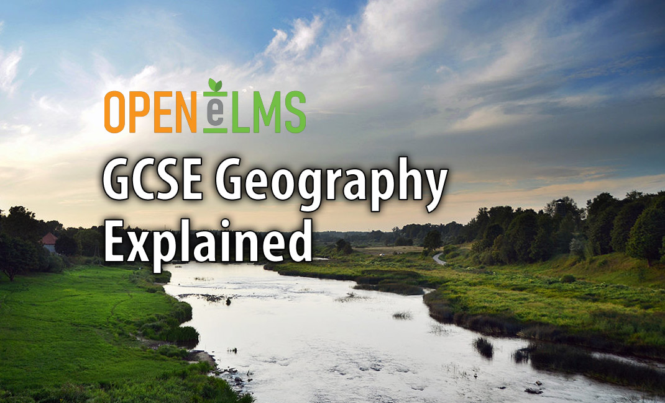


Slide 2
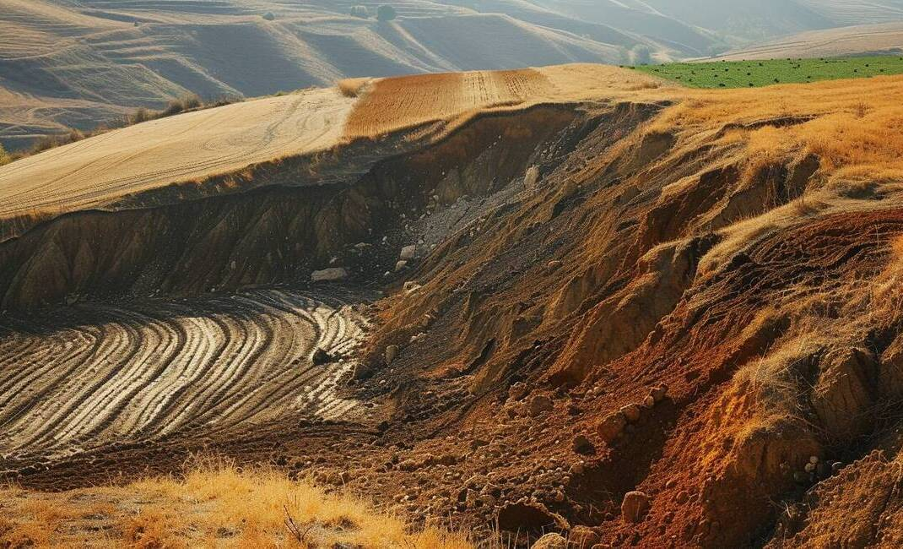
Introduction to Geography
Geography explores people-environment relationships
Physical geography studies natural systems
Human geography examines societal impacts
Geography enhances global awareness
Geographers propose sustainable solutions
Notes:
Geography explores people-environment relationships: Geography is a broad discipline that looks at how humans interact with their environment. This includes both the physical aspects, like landforms and climate, and the human aspects, such as culture and economy.
Physical geography studies natural systems: Physical geography focuses on the Earth's natural features and processes. Understanding elements like climate and ecosystems is vital for addressing environmental issues and recognizing the impact of natural disasters.
Human geography examines societal impacts: Human geography investigates how human activities shape our world. It looks at population distribution and urbanization, analyzing how these factors contribute to global challenges such as climate change.
Geography enhances global awareness: Studying geography fosters a deeper appreciation for the diversity of cultures and environments. This understanding is crucial for navigating international relations and promoting empathy among different nations.
Geographers propose sustainable solutions: By analyzing the interactions between human activities and the environment, geographers can suggest strategies to improve sustainability. Their insights are essential for enhancing the quality of life in communities around the world.

Slide 3
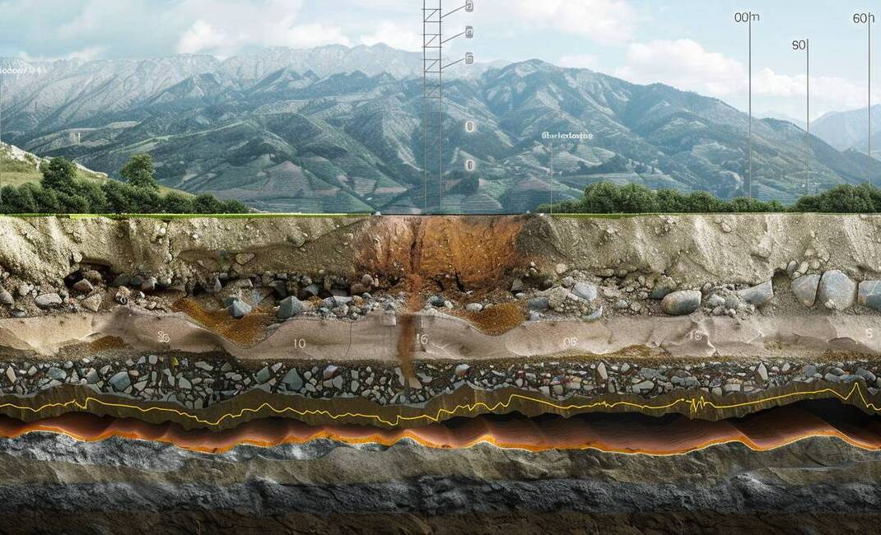
The Earth's Structure
Earth's layers: crust, mantle, core
Crust: thin, solid rock layer
Mantle: viscous, convective layer
Core: outer liquid, inner solid
Tectonic plates cause geological activity
Seismic waves reveal Earth's structure
Notes:
Earth's layers: crust, mantle, core: The Earth is structured in distinct layers, each with unique properties. The outer crust is where we live, while the mantle and core play critical roles in geological processes.
Crust: thin, solid rock layer: The crust is the Earth's outermost layer and is relatively thin compared to the layers beneath it. It consists of solid rock and is divided into tectonic plates that float on the semi-fluid mantle.
Mantle: viscous, convective layer: Beneath the crust lies the mantle, extending to about 2,900 kilometers deep. It is composed of silicate rocks and behaves like a viscous fluid, driving tectonic plate movement through convection currents.
Core: outer liquid, inner solid: The Earth's core has two parts: the outer core, which is liquid and generates the magnetic field, and the inner core, which is solid and extremely hot, primarily made of iron.
Tectonic plates cause geological activity: The interactions of tectonic plates at the crust level lead to significant geological phenomena like earthquakes and volcanic eruptions. Understanding these interactions is key to studying Earth's dynamic nature.
Seismic waves reveal Earth's structure: Geologists use seismic wave analysis to study the Earth's internal structure. By examining how these waves travel and change speed, scientists can infer the composition and state of the Earth's layers.

Slide 4
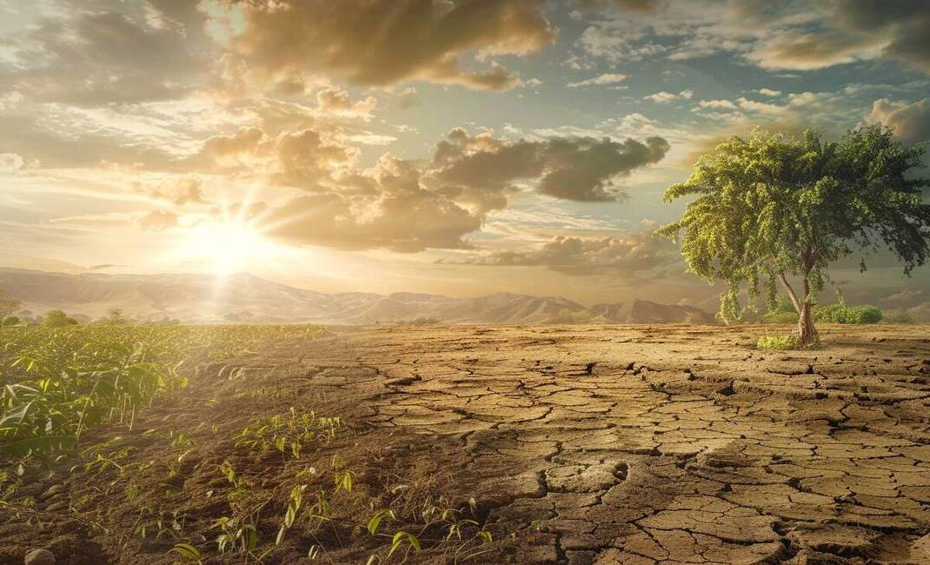
Weather and Climate
Weather: Short-term atmospheric conditions
Climate: Long-term weather averages
Factors influencing weather and climate
Importance of weather forecasting
Impact of climate change
Notes:
Weather: Short-term atmospheric conditions: Weather describes the immediate atmospheric conditions in a specific area, such as temperature and humidity. It's important to highlight how rapidly weather can change, impacting daily life and activities.
Climate: Long-term weather averages: Climate refers to the average weather conditions over a long period, typically 30 years. This distinction is crucial for understanding regional characteristics and how they affect ecosystems and human activities.
Factors influencing weather and climate: Key factors such as latitude, altitude, and proximity to water bodies significantly influence both weather and climate. Discuss how these elements contribute to temperature variations and precipitation patterns.
Importance of weather forecasting: Weather forecasting combines observational data and technology to predict short-term weather changes. Emphasize how accurate forecasts are vital for community safety and preparedness against severe weather events.
Impact of climate change: Climate change is a pressing global issue that alters weather patterns and climate stability. Explain how human activities contribute to this change and the potential consequences for ecosystems and societies.

Slide 5
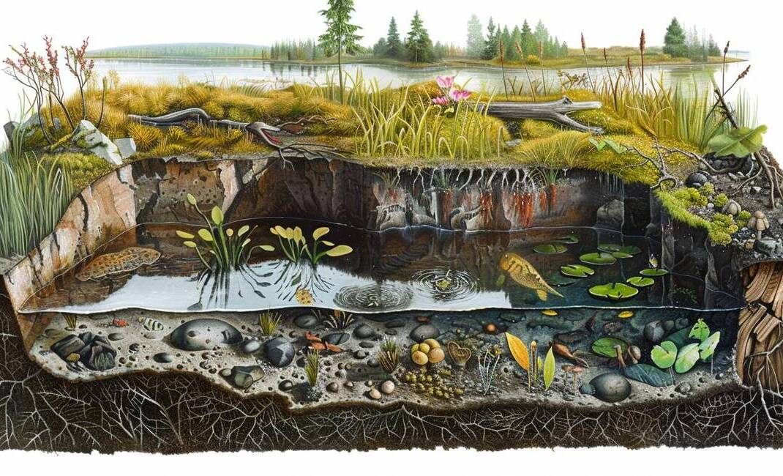
Ecosystems
Ecosystems are complex networks
Types of interactions in ecosystems
Dynamic nature of ecosystems
Importance of biodiversity
Conservation and ecosystem services
Understanding ecosystems for sustainability
Notes:
Ecosystems are complex networks: Ecosystems consist of living organisms and their interactions with the environment. It's important to emphasize that these networks can vary significantly in size and composition, from small ponds to large rainforests.
Types of interactions in ecosystems: Ecosystems are characterized by various interactions, including predation, competition, and symbiosis. Each of these interactions plays a crucial role in maintaining the balance and health of the ecosystem.
Dynamic nature of ecosystems: Ecosystems are not static; they are constantly changing due to natural events and human activities. Highlight how factors like wildfires and urbanization can dramatically alter ecosystem structures and functions.
Importance of biodiversity: Biodiversity is vital for ecosystem resilience and stability. A diverse ecosystem can adapt better to environmental changes, making conservation efforts essential for maintaining these diverse species.
Conservation and ecosystem services: Conservation is critical for protecting ecosystems and the services they provide, such as clean air and water. Discuss how these services are crucial for human survival and well-being.
Understanding ecosystems for sustainability: Studying ecosystems helps us address global challenges like climate change. By understanding the relationships within ecosystems, we can create effective policies for sustainability and environmental protection.

Slide 6
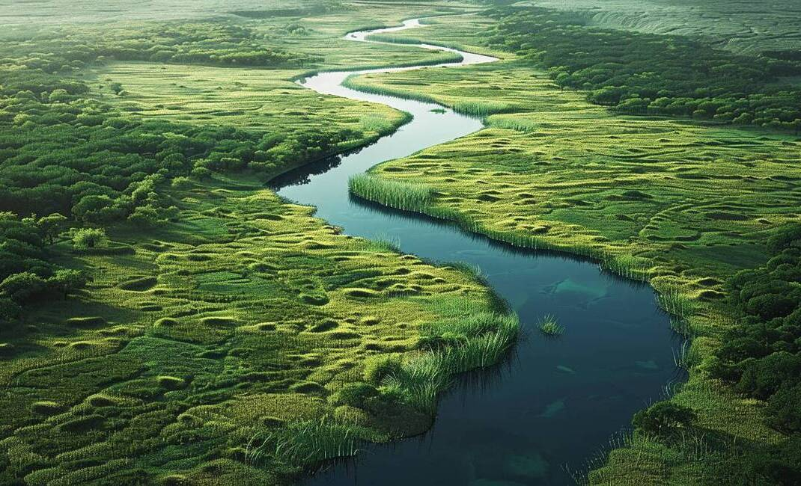
Rivers and Coasts
Rivers shape landscapes and ecosystems
Coastal areas are dynamic environments
Human impact on rivers and coasts
Climate change affects water systems
Importance of integrated management strategies
Notes:
Rivers shape landscapes and ecosystems: Rivers play a crucial role in sculpting our landscapes through processes like erosion, transportation, and deposition. This not only creates physical features such as valleys and deltas but also supports diverse ecosystems that depend on these water systems.
Coastal areas are dynamic environments: Coastal regions are where land meets sea, and they are influenced by natural forces like tides and waves, as well as human activities. This dynamic interaction fosters unique ecosystems, such as estuaries, which are vital for various species and ecological health.
Human impact on rivers and coasts: Human activities, including construction and pollution, significantly affect both rivers and coastal ecosystems. It’s important to discuss how these actions can lead to habitat loss and degradation, emphasizing the need for sustainable practices in these environments.
Climate change affects water systems: Climate change poses significant threats to rivers and coasts, including rising sea levels and altered precipitation patterns. These changes can lead to increased flooding and impact water quality, highlighting the importance of adaptive management strategies.
Importance of integrated management strategies: To address the challenges facing rivers and coasts, we must adopt integrated management strategies that consider both ecological processes and human needs. This approach is essential for ensuring the resilience and sustainability of these vital ecosystems.

Slide 7
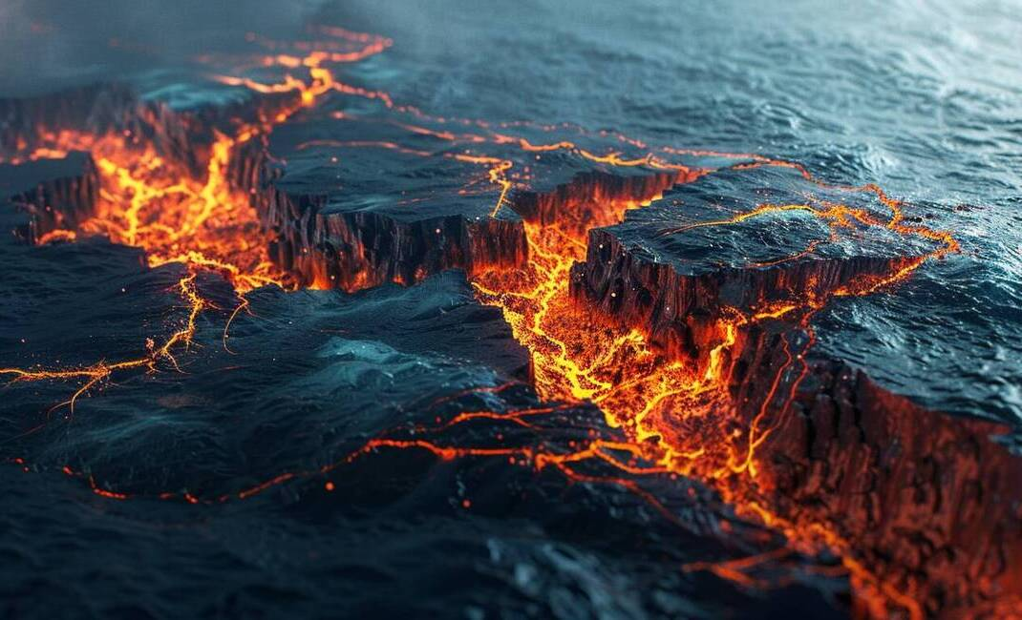
Tectonic Processes
Tectonic plates shape Earth's surface
Three types of plate boundaries
Driving forces of plate movement
Natural hazards from tectonic processes
Importance for disaster preparedness
Tectonics shape Earth's landscape
Notes:
Tectonic plates shape Earth's surface: Tectonic processes are essential for understanding how the Earth's surface is constantly changing. The lithosphere's movement, divided into tectonic plates, leads to significant geological phenomena that we observe today.
Three types of plate boundaries: There are three main types of plate boundaries: divergent, convergent, and transform. Each type of boundary leads to different geological activities, such as new crust formation at divergent boundaries and earthquakes at transform boundaries.
Driving forces of plate movement: The movement of tectonic plates is driven by several forces, including mantle convection, slab pull, and ridge push. Understanding these forces helps explain why plates move and interact in various ways.
Natural hazards from tectonic processes: Tectonic processes are responsible for natural hazards like earthquakes and volcanic eruptions. These events occur due to the stress and energy released at plate boundaries, which can have devastating effects on communities.
Importance for disaster preparedness: Studying tectonic processes is crucial for disaster preparedness and risk management. By analyzing historical data on plate movements, scientists can predict potential hazards and help communities build safer infrastructure.
Tectonics shape Earth's landscape: Over geological time, tectonic processes have shaped the Earth's landscape, creating features like mountain ranges and ocean basins. This ongoing activity is a vital area of study in physical geography, influencing our understanding of the planet.

Slide 8

Population and Urbanization
Population geography examines human distribution
Urbanization drives migration to cities
Megacities face significant disparities
Urban growth impacts the environment
Diversity enhances urban cultural dynamics
Sustainable development balances growth and ecology
Notes:
Population geography examines human distribution: Population geography is essential for understanding how human populations are spread across regions. It helps us analyze the factors influencing population movement, which is crucial for effective resource allocation and urban planning.
Urbanization drives migration to cities: Urbanization is primarily fueled by people moving from rural areas to urban centers in search of better opportunities. This migration is often motivated by the desire for improved employment, education, and healthcare.
Megacities face significant disparities: As urban populations swell, megacities emerge, often characterized by stark social and economic inequalities. Wealth may be concentrated in certain areas, while others struggle with poverty and lack of essential services, highlighting the need for comprehensive urban policies.
Urban growth impacts the environment: The rapid expansion of urban areas poses serious environmental challenges. Cities consume vast resources and generate waste, leading to habitat destruction and increased carbon emissions, necessitating a focus on sustainable urban development.
Diversity enhances urban cultural dynamics: Urbanization fosters cultural diversity as populations become more varied. This diversity can lead to innovation and cultural exchanges, but it also presents challenges in achieving social cohesion and integration among different community groups.
Sustainable development balances growth and ecology: To address the challenges posed by urbanization, sustainable development practices are essential. This includes promoting green spaces, efficient public transport, and renewable energy to ensure that urban growth does not come at the expense of environmental health.

Slide 9

Economic Activities
Four main economic sectors
Primary sector: resource extraction
Secondary sector: manufacturing processes
Tertiary sector: service-oriented
Quaternary sector: knowledge-based activities
Interconnectedness of economic sectors
Regional variations in economic sectors
Notes:
Four main economic sectors: Economic activities are categorized into four sectors: primary, secondary, tertiary, and quaternary. Each sector plays a distinct role in the economy, from resource extraction to service provision, shaping how economies function and develop.
Primary sector: resource extraction: The primary sector focuses on extracting and harvesting natural resources, such as agriculture and mining. This sector is foundational, providing essential raw materials for the secondary sector and employment opportunities for many.
Secondary sector: manufacturing processes: In the secondary sector, raw materials are transformed into finished goods through manufacturing and industrial processes. This sector's growth is linked to urbanization and technological advancements that enhance productivity.
Tertiary sector: service-oriented: The tertiary sector encompasses service industries like healthcare, education, and tourism. Its growth reflects a shift in consumer behavior and is crucial for job creation, significantly contributing to GDP in many nations.
Quaternary sector: knowledge-based activities: The quaternary sector involves knowledge-based activities such as R&D and IT services. It emphasizes innovation and advanced technology, playing an increasingly vital role in driving economic growth as economies evolve.
Interconnectedness of economic sectors: Understanding the interplay between these sectors is essential for analyzing economic development. Changes in one sector, like technological advancements in the quaternary sector, can enhance productivity in others, illustrating their interconnected nature.
Regional variations in economic sectors: Economic activities differ across regions, influenced by geography and cultural practices. Developing countries may focus more on the primary sector, while developed nations often have a larger tertiary and quaternary sector, highlighting global economic dynamics.

Slide 10

Development and Globalization
Definition of Development
Understanding Globalization
Complex Relationship: Development and Globalization
Impact on Labor Markets
Environmental Sustainability Challenges
Need for Equitable Development Strategies
Notes:
Definition of Development: Development is the process aimed at improving economic, social, and political well-being in a region. It includes enhancements in income, education, healthcare, and infrastructure, which are vital for reducing inequalities and promoting sustainable growth.
Understanding Globalization: Globalization connects businesses, cultures, and economies globally, driven by advancements in technology and communication. This interconnectivity can foster economic growth and cultural exchange, but it also raises concerns about cultural homogenization and local identity loss.
Complex Relationship: Development and Globalization: The interplay between development and globalization is intricate. While globalization offers developing countries access to new markets and technologies, it can also deepen inequalities, leading to uneven development outcomes across different regions.
Impact on Labor Markets: Globalization significantly influences labor markets, often resulting in job outsourcing to countries with lower labor costs. While this can stimulate economic growth in those countries, it may simultaneously cause job losses and wage stagnation in developed nations.
Environmental Sustainability Challenges: The rise of globalization can negatively affect environmental sustainability, as increased production and consumption may lead to resource depletion. Addressing these challenges requires international cooperation and the adoption of sustainable practices that balance economic growth with environmental protection.
Need for Equitable Development Strategies: To harness the benefits of globalization while mitigating its challenges, it is crucial to develop equitable strategies. These strategies should take into account the diverse needs of all stakeholders to ensure that globalization supports sustainable development for everyone.

Slide 11

Sustainable Development
Holistic approach to development
Principle of equity emphasized
Focus on environmental sustainability
Economic sustainability for growth
Collaboration among stakeholders needed
Education and awareness are vital
Commitment to future generations
Notes:
Holistic approach to development: Sustainable development is not just about economic growth; it integrates social and environmental aspects. This holistic approach ensures that we consider the long-term effects of our actions on both people and the planet.
Principle of equity emphasized: Equity is a cornerstone of sustainable development, ensuring all individuals have access to essential resources. By addressing issues like poverty and education, we can create a more just society where everyone has the opportunity to thrive.
Focus on environmental sustainability: Environmental sustainability is crucial for preserving our natural resources. This involves reducing pollution, conserving biodiversity, and combating climate change, which are essential for maintaining a healthy ecosystem for future generations.
Economic sustainability for growth: Economic sustainability promotes long-term growth while ensuring efficient resource use. By investing in green technologies and sustainable business practices, we can build economies that are resilient and environmentally friendly.
Collaboration among stakeholders needed: Achieving sustainable development requires collaboration between governments, businesses, and communities. Working together, these stakeholders can create effective policies and initiatives that promote sustainability on multiple levels.
Education and awareness are vital: Education plays a key role in sustainable development. Informed citizens can advocate for sustainable practices, hold decision-makers accountable, and contribute to creating a more sustainable future.
Commitment to future generations: Sustainable development is about ensuring that future generations inherit a healthy planet and a thriving society. By balancing economic, social, and environmental priorities, we can create a sustainable future for all.

Slide 12
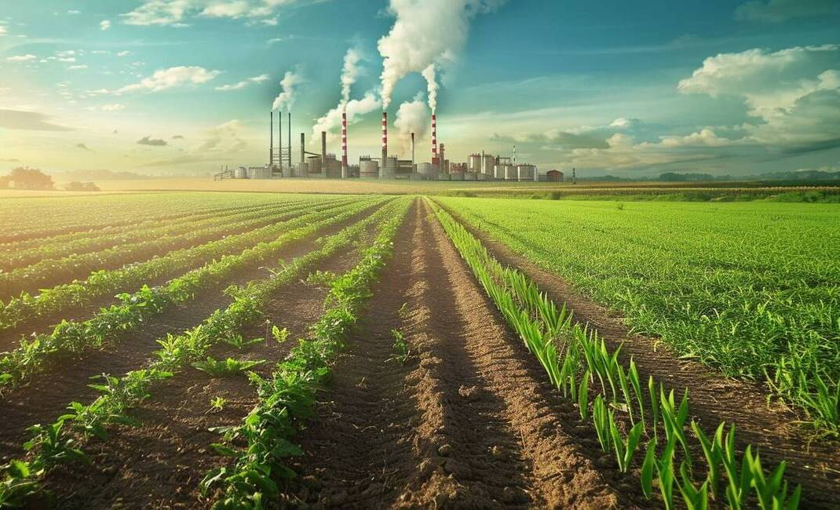
Human Impact on the Environment
Deforestation's ecological consequences
Pollution's health and ecosystem effects
Climate change from human activities
Urbanization and habitat loss
Overexploitation of natural resources
Importance of conservation efforts
Notes:
Deforestation's ecological consequences: Deforestation leads to significant habitat loss and threatens biodiversity. As forests are cleared for agriculture and urban development, we see a decline in various species and disruption of the carbon cycle, which is essential for maintaining our planet's climate.
Pollution's health and ecosystem effects: Human activities release harmful pollutants into our environment, impacting both human health and ecosystems. It's important to understand how industrial processes and improper waste disposal contribute to air, water, and soil pollution, leading to serious health risks and environmental degradation.
Climate change from human activities: Climate change is primarily driven by human-induced greenhouse gas emissions from burning fossil fuels and deforestation. This warming trend results in extreme weather, rising sea levels, and the displacement of communities, highlighting the urgent need for action to mitigate these impacts.
Urbanization and habitat loss: As urban areas expand, they replace natural landscapes with concrete, leading to habitat destruction and increased runoff. Urban heat islands exacerbate energy consumption and air quality issues, making it crucial to consider sustainable urban planning.
Overexploitation of natural resources: Unsustainable practices in resource management can lead to significant depletion and degradation of vital natural resources. This includes overfishing, excessive water use, and poor agricultural practices, which threaten our ability to sustain these resources for future generations.
Importance of conservation efforts: Conservation initiatives like reforestation and pollution control are essential for restoring ecosystems and preserving biodiversity. By adopting sustainable practices and raising awareness, we can all play a role in creating a healthier environment for future generations.

Slide 13

Conclusion and Review
Physical geography fundamentals
Human geography interactions
Importance of sustainable development
Geography is dynamic
Engage with local environments
Notes:
Physical geography fundamentals: We explored the basics of physical geography, which includes natural processes like landforms and climate. Understanding these elements is essential as they directly influence human activities and our environment.
Human geography interactions: Human geography focuses on how societies interact with their environment. This includes studying urbanization and economic activities, which helps us grasp the challenges and opportunities faced globally.
Importance of sustainable development: Throughout the course, we highlighted the need for sustainable development. Balancing economic growth with environmental protection is crucial, especially as we confront issues like climate change and resource depletion.
Geography is dynamic: Geography is not static; it evolves with new research and technology. Staying updated with current events in geography will enhance your understanding and prepare you for future challenges in the field.
Engage with local environments: I encourage you to apply what you've learned by engaging with your local environment. Participating in field studies and community projects can deepen your understanding and foster a more sustainable society.

