Slide 1

Genesis: A Biblical Tale

Slide 2

The Cosmic Kickoff
God's creative act initiated existence
Earth was formless and void
Divine electrician analogy
The significance of 'Let there be light'
Notes:
God's creative act initiated existence: This bullet point emphasizes that the act of creation by God marks the beginning of everything we know. It’s important to highlight how this reflects the power and intention behind the creation of the universe.
Earth was formless and void: Here, we discuss the initial state of the earth as chaotic and empty. This sets the stage for understanding the transformative power of God’s words in the creation narrative.
Divine electrician analogy: Using the analogy of a divine electrician helps to illustrate God's role in bringing order from chaos. It makes the concept more relatable by comparing divine creation to something familiar.
The significance of 'Let there be light': This phrase is pivotal in the creation story, symbolizing the introduction of order and clarity. It represents not only physical light but also the illumination of knowledge and understanding.

Slide 3
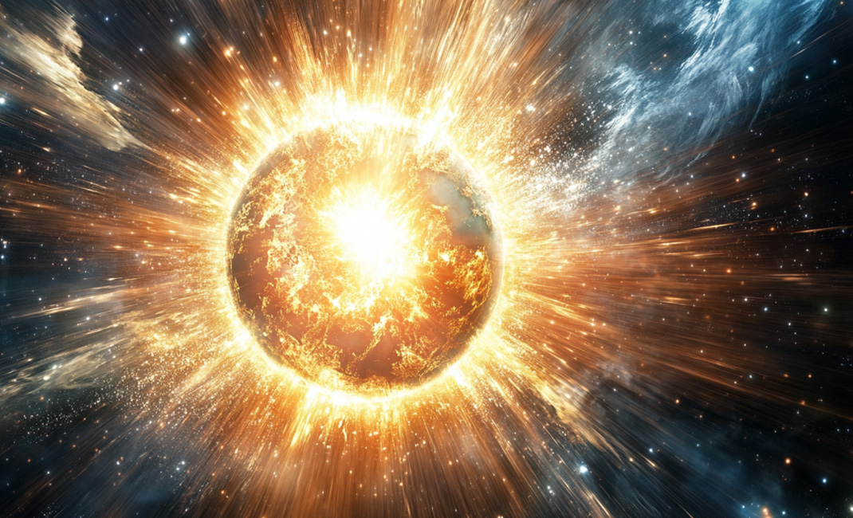
<p>Cosmic Question</p>
Creation story in religious texts
Scientific perspective on Earth's formation
Metaphor of cosmic chef
Comparison of creation timelines
Faith versus scientific reasoning
Notes:
Creation story in religious texts: The religious narrative often presents a rapid creation of the Earth and sky, emphasizing the power of a divine being. This story serves to inspire faith and wonder, illustrating the belief in a higher power's ability to create the universe.
Scientific perspective on Earth's formation: In contrast to the biblical account, scientists provide evidence that the Earth formed over billions of years through complex processes. This highlights the importance of understanding scientific theories alongside religious beliefs.
Metaphor of cosmic chef: The metaphor of a 'cosmic chef' helps illustrate the idea of creation in a relatable way. It captures the imagination while also prompting us to think critically about the nature of creation stories.
Comparison of creation timelines: The stark difference between the quick creation in religious texts and the lengthy scientific timeline invites discussion. It encourages learners to explore how different cultures and disciplines interpret the origins of the Earth.
Faith versus scientific reasoning: This topic raises questions about the relationship between faith and science. It's essential to acknowledge that both can coexist and provide different insights into the same fundamental questions about existence.

Slide 4

The Firmament Formation
God's DIY project on Day Two
Separation of waters above and below
Naming the firmament 'Heaven'
Firmament as a room divider
Notes:
God's DIY project on Day Two: On the second day of creation, God undertook a significant task by creating the firmament. This DIY project illustrates God's active role in shaping the world.
Separation of waters above and below: The firmament serves as a divider between the waters above, which can be understood as the clouds or sky, and the waters below, representing the seas. This separation is crucial in the creation narrative.
Naming the firmament 'Heaven': God named the firmament 'Heaven,' indicating its importance in the creation process. This term not only designates a physical space but also carries spiritual significance.
Firmament as a room divider: The firmament is described as the ultimate room divider, emphasizing its role in organizing the cosmos. This metaphor highlights how God structured creation to establish order.

Slide 5

Terra Firma and Botanical Bonanza
God created dry land
Introduction of plant life
Self-replicating plants
Symbolism of greenery
Notes:
God created dry land: On the third day of creation, God gathered the waters to reveal the dry land, which He named 'Earth.' This act signifies the establishment of a solid foundation for life.
Introduction of plant life: Following the creation of dry land, God introduced various forms of plant life, including grass, herbs, and fruit trees. This highlights the importance of vegetation in the ecosystem.
Self-replicating plants: God ensured that all plants had the ability to self-replicate, which is crucial for the sustainability of life on Earth. This reflects a divine design for abundance and continuity in nature.
Symbolism of greenery: The emergence of greenery symbolizes not just beauty but also the essential role plants play in supporting life. It sets the stage for a thriving ecosystem that supports various forms of life.

Slide 6
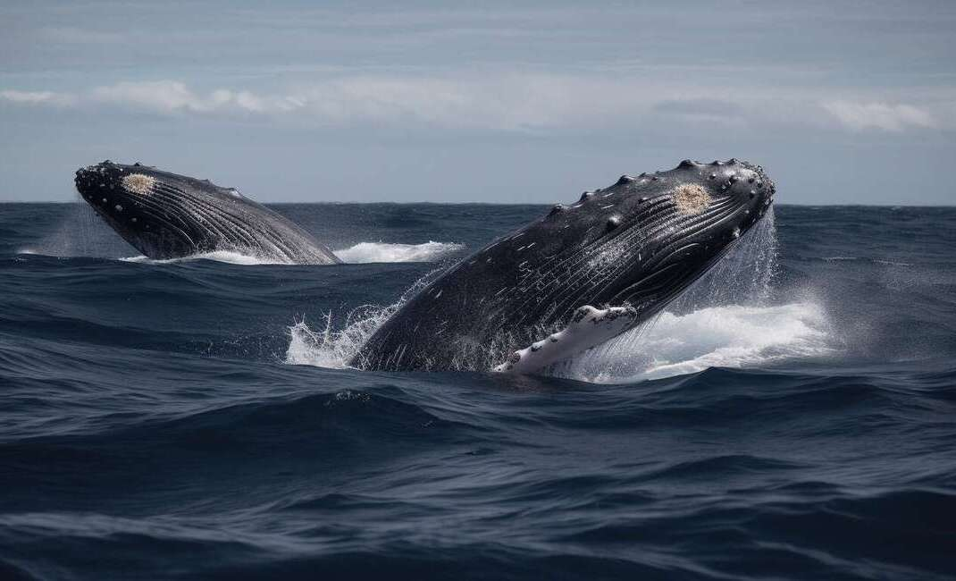
Stellar Stuff and Swimming Species
God created celestial bodies
Life in the waters
Birds released to the sky
Blessing of multiplication
Notes:
God created celestial bodies: On day four of creation, God established the sun, moon, and stars. These celestial bodies were not only for illumination but also serve as markers for time, guiding the rhythms of day and night.
Life in the waters: On day five, God introduced life into the waters, filling them with various species. This act emphasizes the diversity and abundance of life that God created, showcasing His creativity and power.
Birds released to the sky: Alongside marine life, God also created birds to inhabit the skies. This signifies the importance of air and land ecosystems and the role birds play in the balance of nature.
Blessing of multiplication: God blessed both the aquatic and avian creatures with the ability to multiply. This blessing underscores the theme of abundance in creation, as life is meant to thrive and flourish.

Slide 7

Land Lubbers and the Human Hullabaloo
God created land creatures
Humans created in God's image
Humans given dominion over Earth
Simple diet of plants and fruits
Notes:
God created land creatures: On the sixth day of creation, God made a variety of land animals, which included everything from large cattle to small insects. This highlights the diversity of life that was established on Earth.
Humans created in God's image: In a significant moment of creation, humans were made in the image of God. This concept emphasizes the unique role and dignity of human beings in the created order.
Humans given dominion over Earth: Humans were entrusted with the responsibility of stewardship over the Earth. This dominion implies a duty to care for and manage the environment and its resources wisely.
Simple diet of plants and fruits: God provided humans with a straightforward diet consisting of plants and fruits. This not only reflects the initial harmony of creation but also sets a foundation for understanding human nutrition and health.

Slide 8
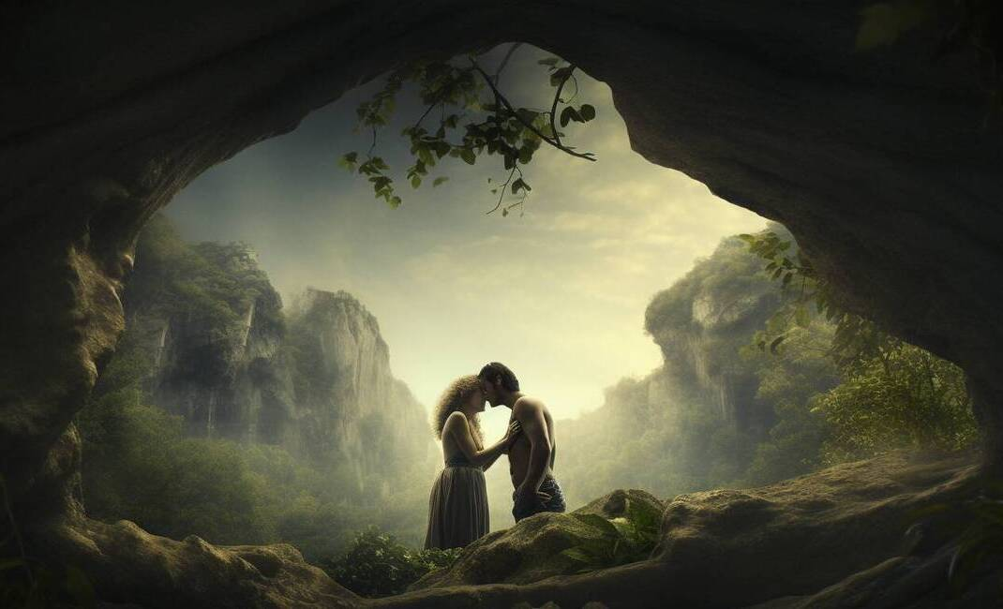
The Seventh Day: Divine Downtime
God rested on the seventh day
Seventh day is blessed and sanctified
Rest as a divine concept
Original weekend established
Completion of God's cosmic tasks
Notes:
God rested on the seventh day: This point emphasizes the significance of rest in the creation narrative. By taking a break, God models the importance of downtime for all of creation.
Seventh day is blessed and sanctified: Highlight how God not only rested but also blessed and set apart the seventh day. This act of sanctification establishes a pattern for future observance of rest.
Rest as a divine concept: Discuss the idea that rest is not merely a human need but a divine principle. It reflects God's character and intention for creation to include periods of rest and reflection.
Original weekend established: Point out that the seventh day represents the original weekend, a time for rejuvenation. This concept of a weekend has profound implications for how we structure our lives today.
Completion of God's cosmic tasks: Explain that God's rest signifies the completion of His work. This teaches us that after fulfilling our responsibilities, taking time to rest is essential for our well-being.

Slide 9
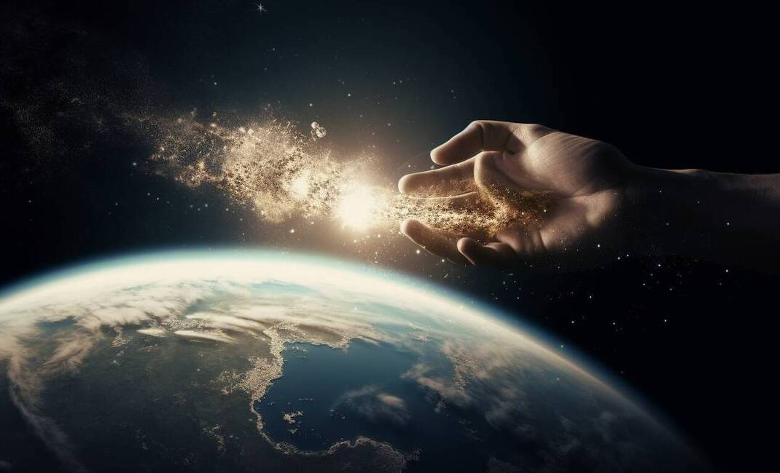
Adam: The Original Gardener
Adam's creation from dust
Breath of life given to Adam
Eden as the first garden
All-you-can-eat buffet concept
Rivers and gold in Eden
Adam's green thumb
Notes:
Adam's creation from dust: Adam was uniquely formed from dust, emphasizing the connection between humanity and the earth. This detail highlights the biblical perspective of human origin and the intrinsic relationship we have with nature.
Breath of life given to Adam: The act of God breathing life into Adam signifies the divine spark that distinguishes humans from other creatures. This moment underscores the importance of life and spirit in the biblical narrative.
Eden as the first garden: The Garden of Eden represents an ideal environment, showcasing abundance and beauty. It serves as a metaphor for paradise and the harmonious relationship between humans and nature.
All-you-can-eat buffet concept: Eden is depicted as a place of unlimited resources, symbolizing God's generosity. However, the concept of one forbidden fruit introduces the idea of choice and temptation in human experience.
Rivers and gold in Eden: The description of rivers and gold illustrates the richness and splendor of Eden. This imagery not only paints a vivid picture but also signifies the blessings that come from living in harmony with God's creation.
Adam's green thumb: Adam's ability to tend to the garden reflects humanity's role as caretakers of the earth. This notion encourages us to consider our responsibilities towards nature and the environment.

Slide 10

The Forbidden Fruit Fiasco
Crafty serpent's deception
Eve's pivotal choice
Adam's complicity
Awareness of nakedness
Notes:
Crafty serpent's deception: The serpent plays a crucial role in this narrative, using cunning persuasion to lead Eve to doubt the command of God. This highlights themes of temptation and the consequences of deception.
Eve's pivotal choice: Eve's decision to eat the forbidden fruit marks a significant turning point in the story. It illustrates the concept of free will and the impact of choices made in the face of temptation.
Adam's complicity: Adam's choice to join Eve in eating the fruit shows a shared responsibility in the act of disobedience. This raises questions about accountability and the dynamics of relationships.
Awareness of nakedness: After eating the fruit, Adam and Eve's realization of their nakedness symbolizes loss of innocence and the onset of shame. This moment serves as a metaphor for the awareness of moral complexities.

Slide 11
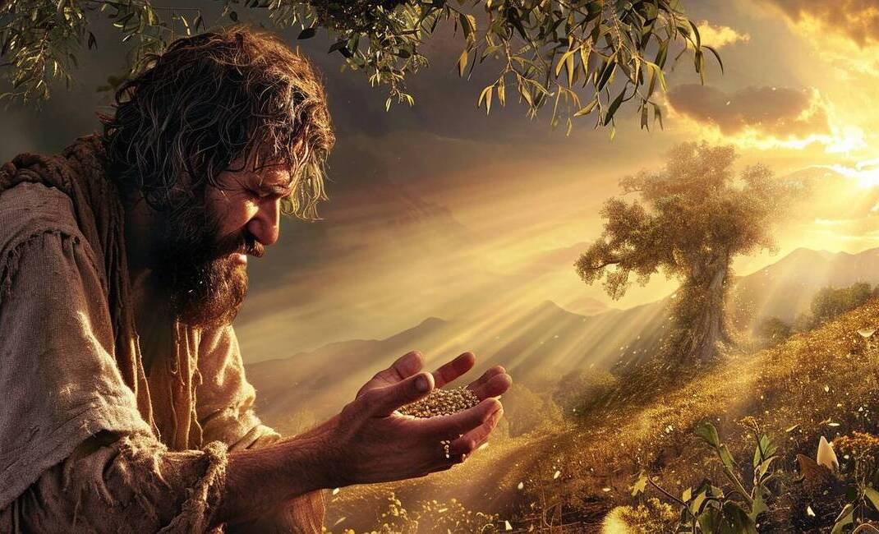
The Blame Game and the Curse
Consequences of disobedience
The blame game initiated
Specific punishments assigned
Impact on the environment
Symbolism of thorns
Notes:
Consequences of disobedience: In this section, we see how disobedience led to immediate consequences for Adam, Eve, and the serpent. It's important to highlight that actions have repercussions, which can affect not just the individual but also their environment.
The blame game initiated: The narrative illustrates the human tendency to deflect blame onto others. This can serve as a discussion point about accountability and how shifting blame can complicate relationships and lead to further issues.
Specific punishments assigned: Each character received specific punishments that reflected their actions. Adam's punishment of labor, Eve's pain in childbirth, and the serpent's grounding symbolize the direct link between behavior and consequences.
Impact on the environment: The curse of the ground and the introduction of thorns signify a broader impact of human choices on the world. This can lead to a conversation about how our actions can have lasting effects on our surroundings and future generations.
Symbolism of thorns: Thorns serve as a powerful symbol of the struggles and challenges that arise from disobedience. Discussing this symbolism can help students understand the deeper meanings behind the text and its relevance to human experience.

Slide 12
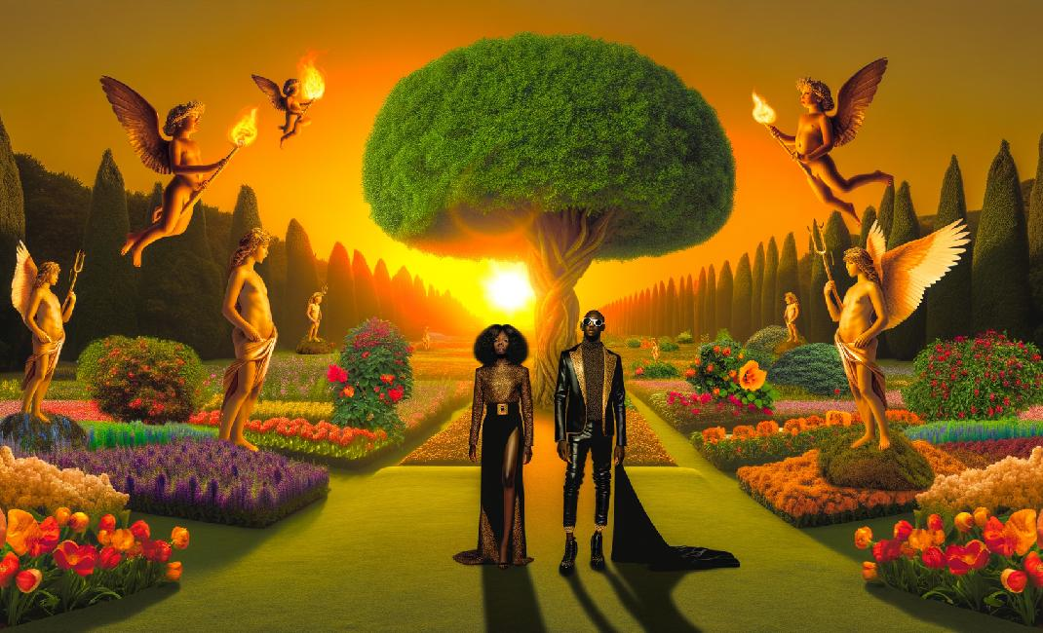
Fashion and Banishment
God's intervention in fashion choices
The concept of banishment
Symbolism of cherubim and sword
Preventing eternal life in sin
Notes:
God's intervention in fashion choices: In this section, we see how God provides leather outfits for Adam and Eve after their shame is revealed. This act signifies a shift in their status and the beginning of their journey outside of Eden.
The concept of banishment: The couple's expulsion from Eden represents a significant turning point in their narrative. It highlights the consequences of their actions and introduces the theme of separation from divine grace.
Symbolism of cherubim and sword: The introduction of cherubim and a flaming sword as guardians of Eden serves as a powerful symbol. It reflects the seriousness of their banishment and the protection of sacred spaces.
Preventing eternal life in sin: God's decision to banish Adam and Eve was also a protective measure to prevent them from living eternally in a state of sin. This raises questions about the nature of free will and the consequences of choices.

Slide 13
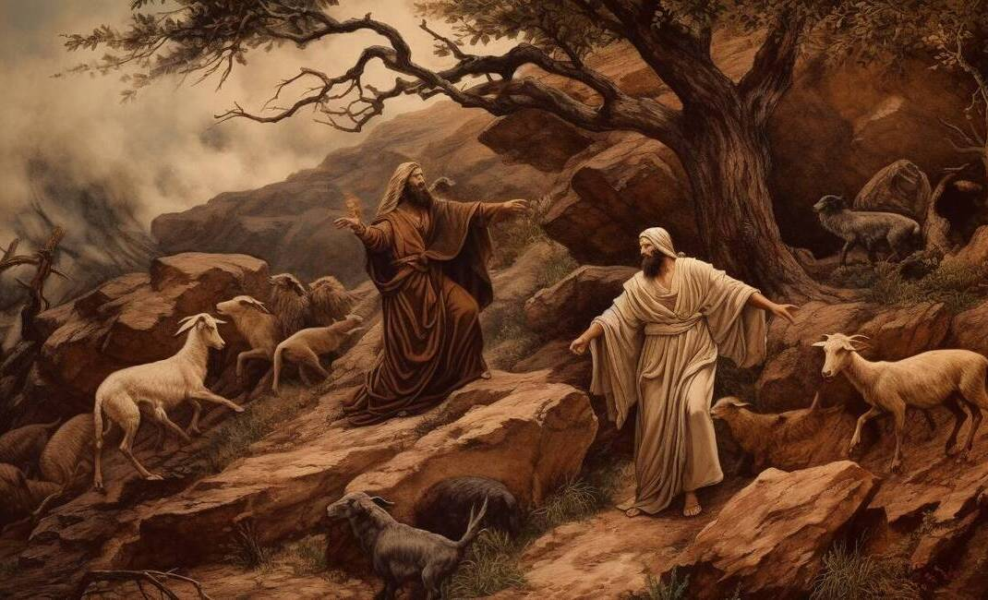
Cain and Abel: Sibling Rivalry Gone Wrong
Cain and Abel's offerings
God's favor towards Abel
Sibling rivalry origins
Fratricide as a consequence
Notes:
Cain and Abel's offerings: Cain was a farmer, while Abel was a shepherd. Both brothers presented offerings to God, but the nature of their gifts was different, which sets the stage for the ensuing conflict.
God's favor towards Abel: God accepted Abel's offering but rejected Cain's. This favoritism sparked feelings of jealousy and resentment in Cain, highlighting how perceived inequality can lead to rivalry.
Sibling rivalry origins: The story illustrates the complexities of sibling relationships, particularly how competition for parental approval can create tension. This is a timeless theme that resonates across various cultures.
Fratricide as a consequence: The rivalry escalated tragically when Cain killed Abel, marking the first murder in biblical history. This act symbolizes the extreme consequences of unchecked jealousy and anger.

Slide 14
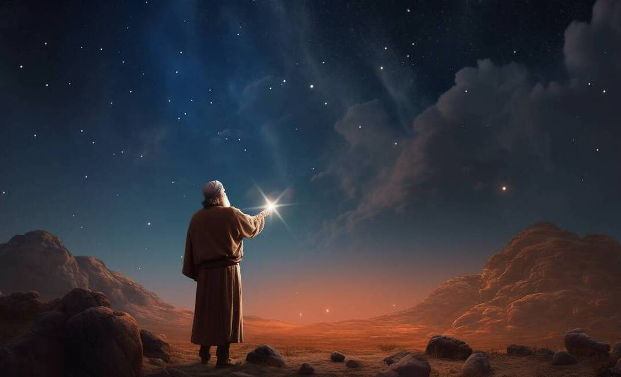
Cain's Consequence and the Land of Nod
Cain's punishment: mark and exile
Nod: a place of wandering
God's promise of protection
Sevenfold vengeance explained
Notes:
Cain's punishment: mark and exile: Cain received a mark from God, which served as both a punishment and a form of protection. This mark indicated his status as a fugitive, but it also showed that God was still looking out for him.
Nod: a place of wandering: The Land of Nod represents a state of exile and wandering. It symbolizes Cain's separation from his family and the consequences of his actions, emphasizing the theme of isolation.
God's promise of protection: Despite Cain's grave sin, God promised him protection by declaring that anyone who harmed him would face sevenfold vengeance. This highlights God's mercy and the complexity of justice.
Sevenfold vengeance explained: The concept of sevenfold vengeance indicates a significant divine retribution for those who would harm Cain. It reflects the seriousness of God's commitment to protect even those who have sinned.

Slide 15
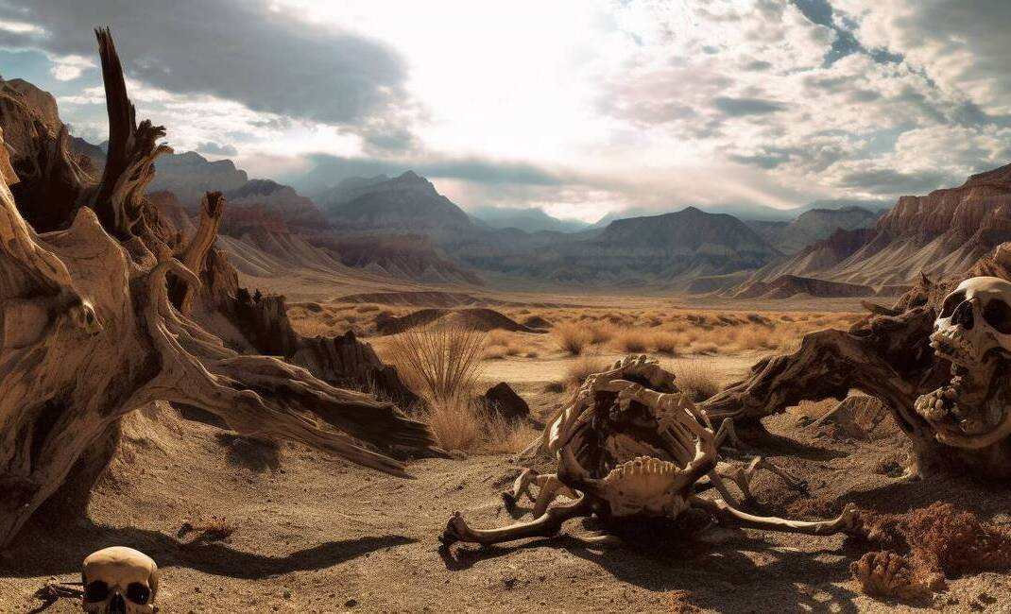
The Lamech Declaration
Lamech's boast of vengeance
Connection to Cain's legacy
Symbolism of the number seventy-seven
Murderous ancestry implications
Notes:
Lamech's boast of vengeance: Lamech, a descendant of Cain, makes a bold declaration about his capacity for vengeance, claiming he can avenge himself seventy-sevenfold. This statement not only highlights his pride but also reflects the escalating cycle of violence that began with Cain.
Connection to Cain's legacy: Lamech's actions and words serve as a direct link to Cain, emphasizing how familial traits, especially negative ones like violence, can persist through generations. This illustrates the idea that behaviors and consequences can be inherited.
Symbolism of the number seventy-seven: The number seventy-seven is significant as it suggests an extreme and exaggerated form of vengeance. It implies that Lamech is not just continuing Cain's legacy, but intensifying it, which serves as a warning about the dangers of unchecked aggression.
Murderous ancestry implications: By referencing Lamech's lineage back to Cain, we see the implications of inherited violence. This serves as a commentary on how past actions can shape future behaviors, raising questions about accountability and moral responsibility.

Slide 16
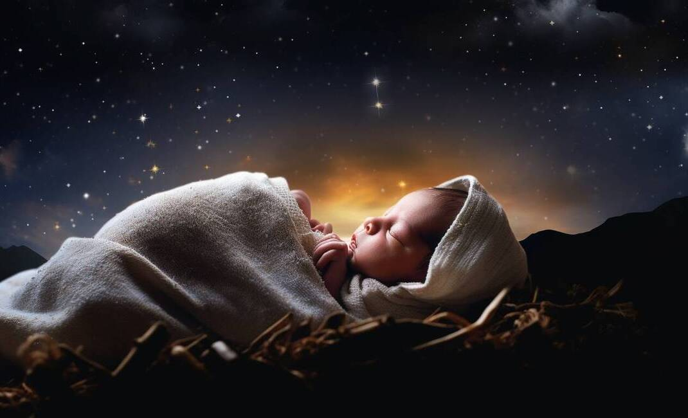
Seth: A New Hope
Seth as a pivotal figure
Enos's role in spiritual awakening
Family drama's impact on faith
Cultural significance of calling on God
Notes:
Seth as a pivotal figure: Seth is significant in the biblical narrative as he represents the continuation of Adam and Eve's lineage. His birth is seen as a new beginning after the turmoil caused by Cain and Abel.
Enos's role in spiritual awakening: Seth's son, Enos, marks a turning point where people begin to actively seek God. This indicates a shift towards spirituality and communal worship in the family line.
Family drama's impact on faith: The previous events involving Cain and Abel created a context of strife, but Seth and Enos's story illustrates how new generations can bring hope and restoration to faith.
Cultural significance of calling on God: The act of calling upon the name of the Lord signifies a deeper relationship with God. It reflects a cultural shift towards seeking divine guidance and support in their lives.

